Slide 1
Rental Property Price Prediction in Warsaw
Igor Hebda
s34836

Slide 2
1. Goal Definition
Create a machine learning model that predicts monthly rental prices for apartments in Warsaw based on property features and location.
Motivation:
The model will help tenants identify fair rental values, assist landlords in setting competitive prices, and provide real estate professionals with data-driven insights for the Warsaw rental market.

Slide 3
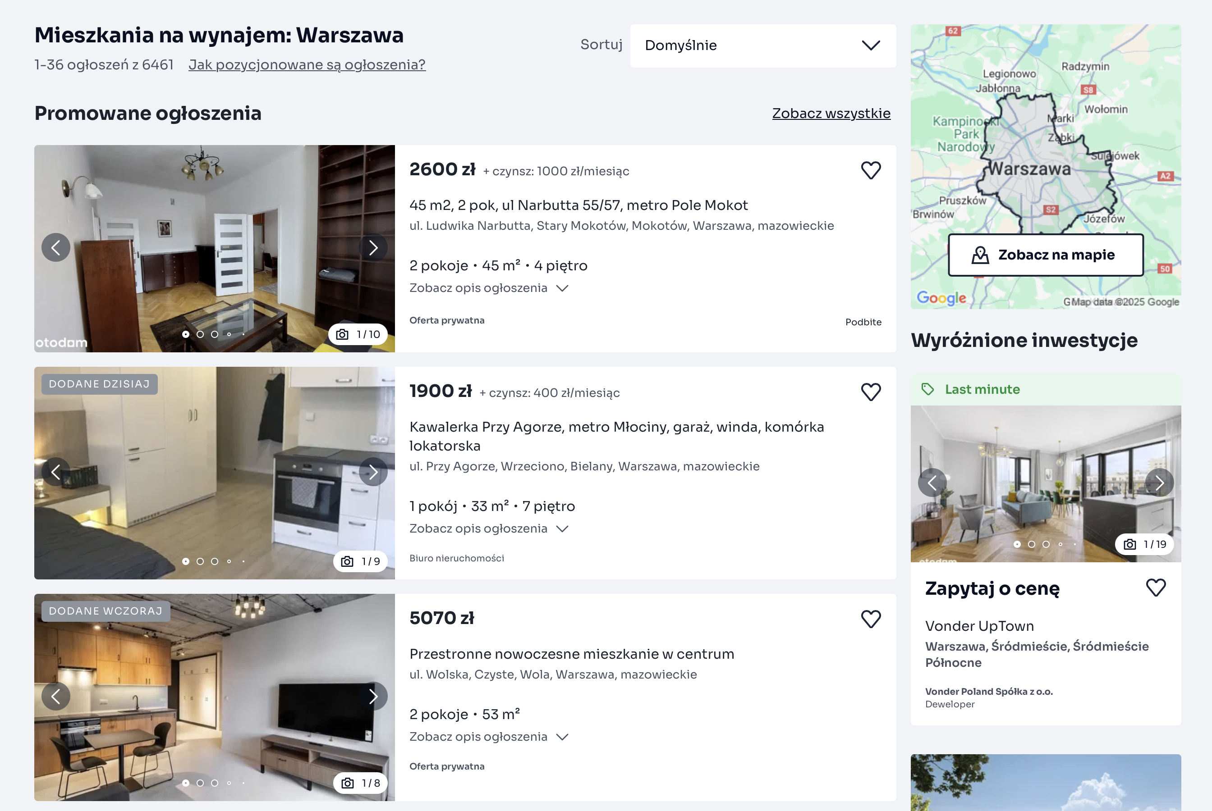
2. Data Collection
Stage 1: Source: otodom.pl
Aim: collect urls of property listings
Execution: script 2-1.py
Output: list of urls

Slide 4
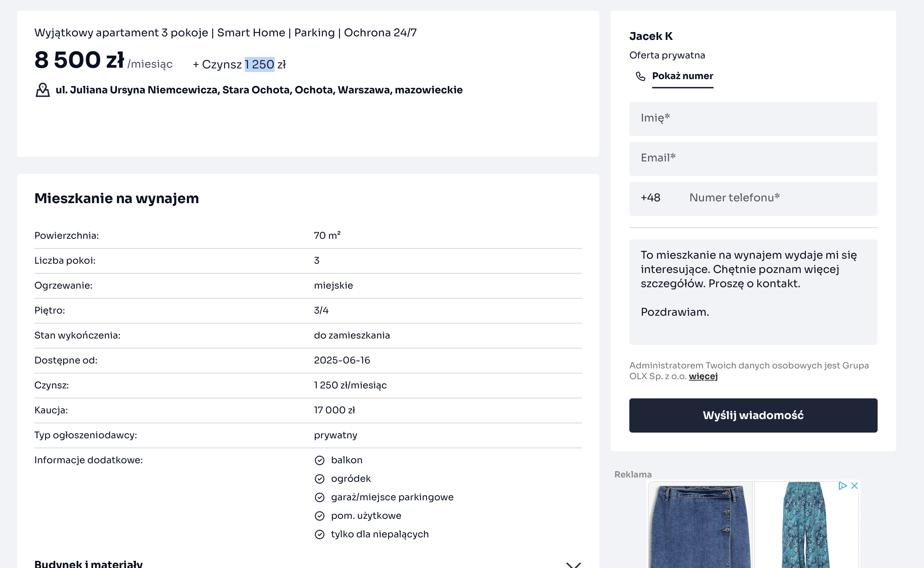
2. Data Collection
Stage 2: Source: otodom.pl
Aim: web scraping of property listings
Execution: script 2-2.py
Output: csv file url, JSON string

Slide 5
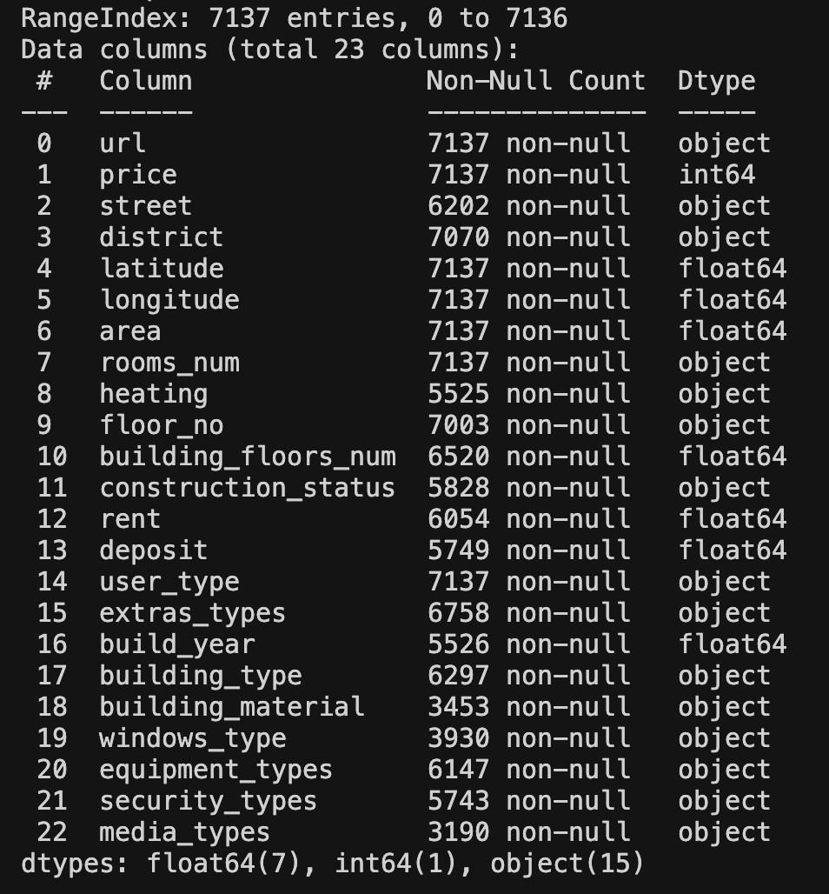
2. Data Collection
Stage 3: Source: JSON
Aim: dataset (bronze layer)
Execution: script 2-3.py
Output: dataframe

Slide 6
2A. Data Pre Preprocessing
1. Drop duplicate urls
2. Total Price = Price + Rent
3. Drop listings with no price
4. Adding price per sqm
5. Creating dummies from list columns
6. Mapping districts
7. Dealing with rooms numer
8. Dealing with build year
9. Dealing with building floors numer
10. Dealing with building types

Slide 7
2A. Data Pre Preprocessing
11. Dealing with windows types
12. Dealing with user types
13. Dealing with heating
14. Dealing with construction status
15. Dealing with building material
16. Dealing with floors
17. Dealing with NaN in floor_numeric
18. Adding distance to center
19. Adding some additional columns
Execution: 2-4.py

Slide 8
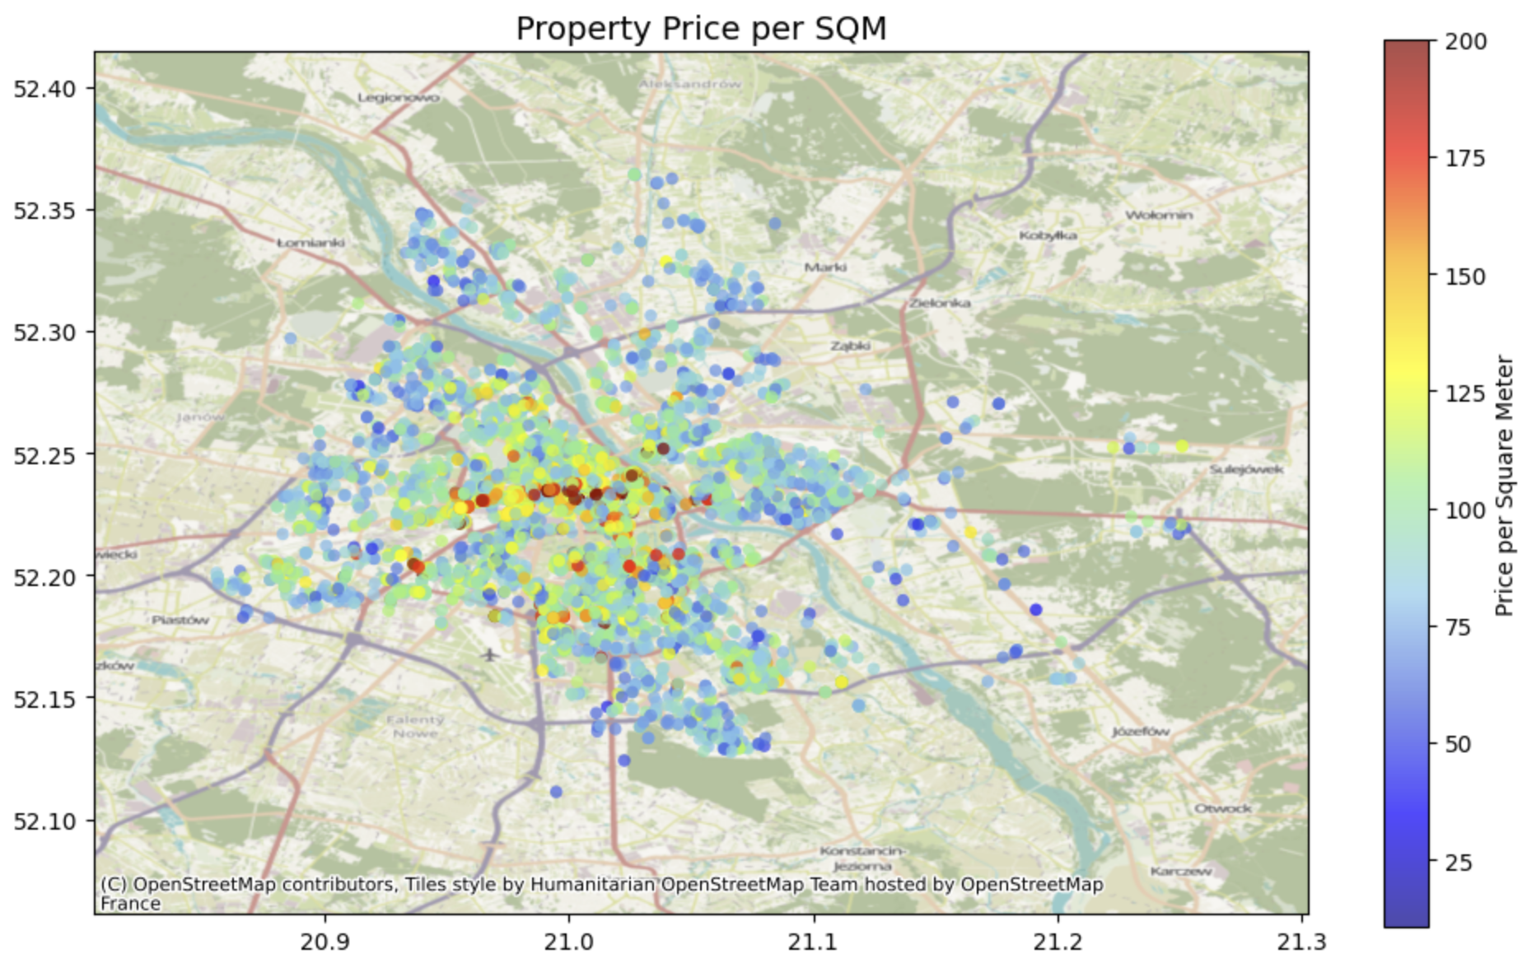
3. Exploratory Data Analysis/ 4. Data Preprocessing

Slide 9
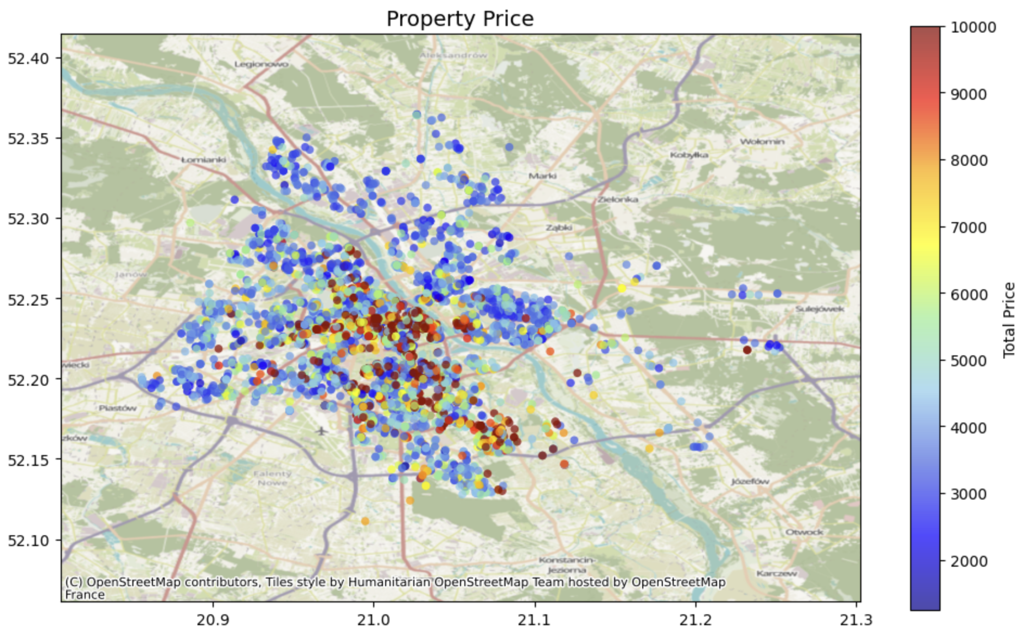

Slide 10
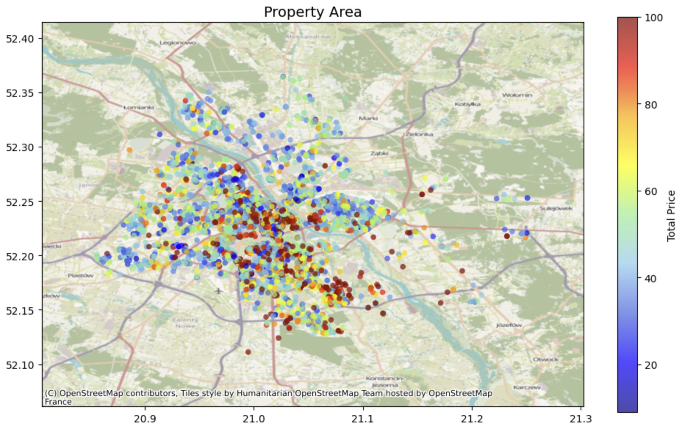

Slide 11
Very Rare Features (< 1%)
Column 0 count 1 count % of 1s
----------------------------------------------------------------------
district_Rembertów 5519 8 0.14%
heating_electrical 5518 9 0.16%
district_Wesoła 5516 11 0.20%
age_pre_1900 5511 16 0.29%
two_storey 5484 43 0.78%
district_Wawer 5483 44 0.80%
district_Unknown 5480 47 0.85%

Slide 12
Uncommon Features (1-5%)
Column 0 count 1 count % of 1s
----------------------------------------------------------------------
window_aluminium 5449 78 1.41%
floor_Special 5441 86 1.56%
district_Praga-Północ 5417 110 1.99%
district_Targówek 5411 116 2.10%
district_Ursus 5395 132 2.39%
size_Huge 5386 141 2.55%
district_Żoliborz 5382 145 2.62%
district_Włochy 5381 146 2.64%
material_concrete 5378 149 2.70%
many_rooms 5377 150 2.71%
district_Bielany 5365 162 2.93%

Slide 13
Uncommon Features (1-5%)
Column 0 count 1 count % of 1s
----------------------------------------------------------------------
heating_gas_heating 5354 173 3.13%
district_Bemowo 5349 178 3.22%
district_Białołęka 5329 198 3.58%
district_Ochota 5327 200 3.62%
material_concrete_plate 5325 202 3.65%
district_Ursynów 5307 220 3.98%
roller_shutters 5301 226 4.09%
age_1980_1999 5297 230 4.16%
district_Other 5278 249 4.51%
height_low_rise 5262 265 4.79%
age_1900_1949 5259 268 4.85%
district_Wilanów 5254 273 4.94%

Slide 14
Features analysis
There is heating_Other 22.71, heating_electrical 0.16% , heating_gas_heating 3.13% and heating_urban 74.00%. Lets combine heating_Other, heating_electrical, heating_gas_heating into heating_combined_other.
There is age_pre_1900 0.29%. Lets combine it with age_1900_1949.
Column two_storey is 0.78%. Lets drop it.
We have: district_Rembertów 0.14%, district_Wesoła 0.20%, district_Wawer 0.80%, district_Unknown 0.85%. Lets combine it to district_other.
We have window_aluminium 1.41%. Lets combine it with window_other.

Slide 15
Outcome of Features analysis
Column 0 count 1 count % of 1s
----------------------------------------------------------------------
floor_Special 5441 86 1.56%
district_Praga-Północ 5417 110 1.99%
district_other 5417 110 1.99%
district_Targówek 5411 116 2.10%
district_Ursus 5395 132 2.39%
size_Huge 5386 141 2.55%
district_Żoliborz 5382 145 2.62%
district_Włochy 5381 146 2.64%
material_concrete 5378 149 2.70%
many_rooms 5377 150 2.71%
…

Slide 16
Correlation analysis
construction_ready_to_use construction_Other 1.000000
heating_combined_other heating_urban 1.000000
user_type_private_owner user_type_agency 1.000000
material_brick material_Other 0.862328
price_per_room price_per_sqm 0.830368
rooms_num area 0.821654
oven fridge 0.816529
washing_machine fridge 0.806308
amenities_score oven 0.786751
floor_numeric floor_VeryHigh 0.785706
price_per_room total_price 0.770090
window_plastic window_Other 0.766108
…

Slide 17
Correlation analysis
Dropping redundant columns ['construction_Other', 'heating_combined_other', 'user_type_private_owner', 'material_Other']

Slide 18
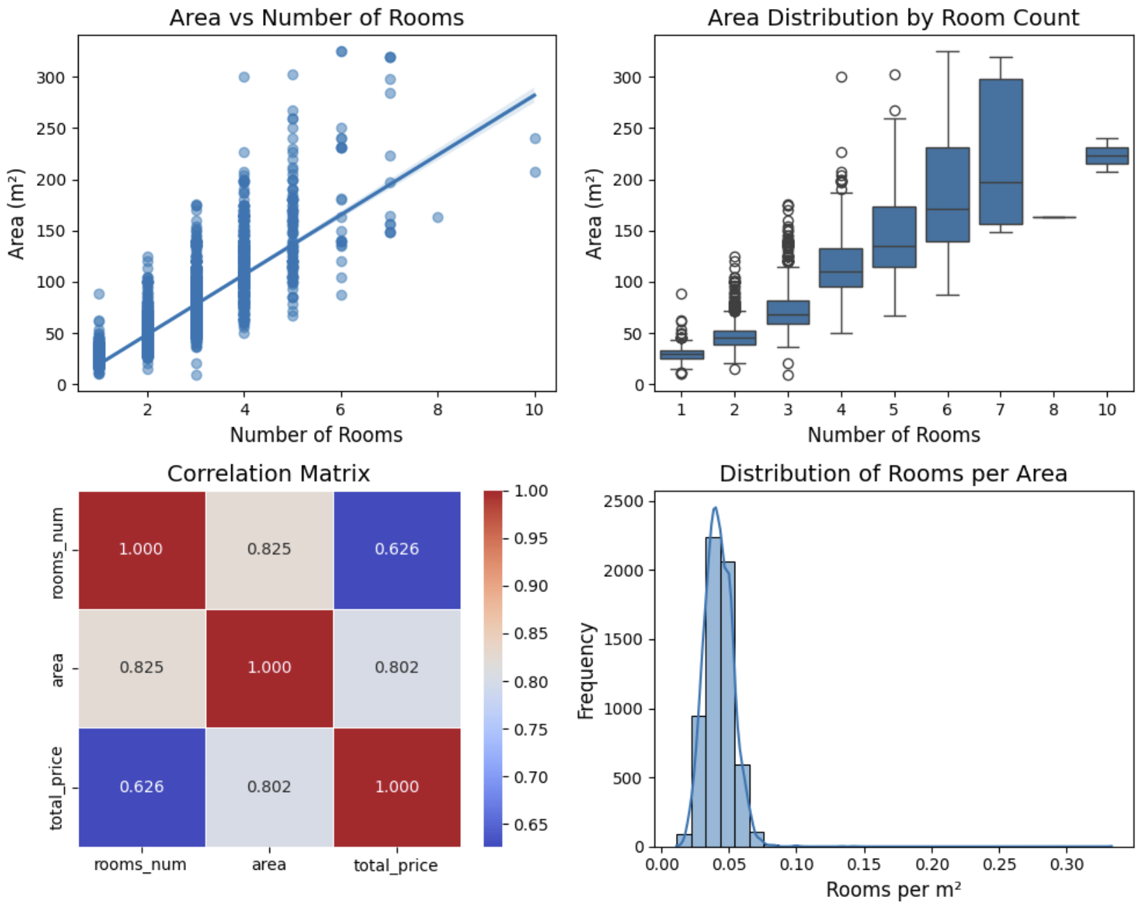

Slide 19
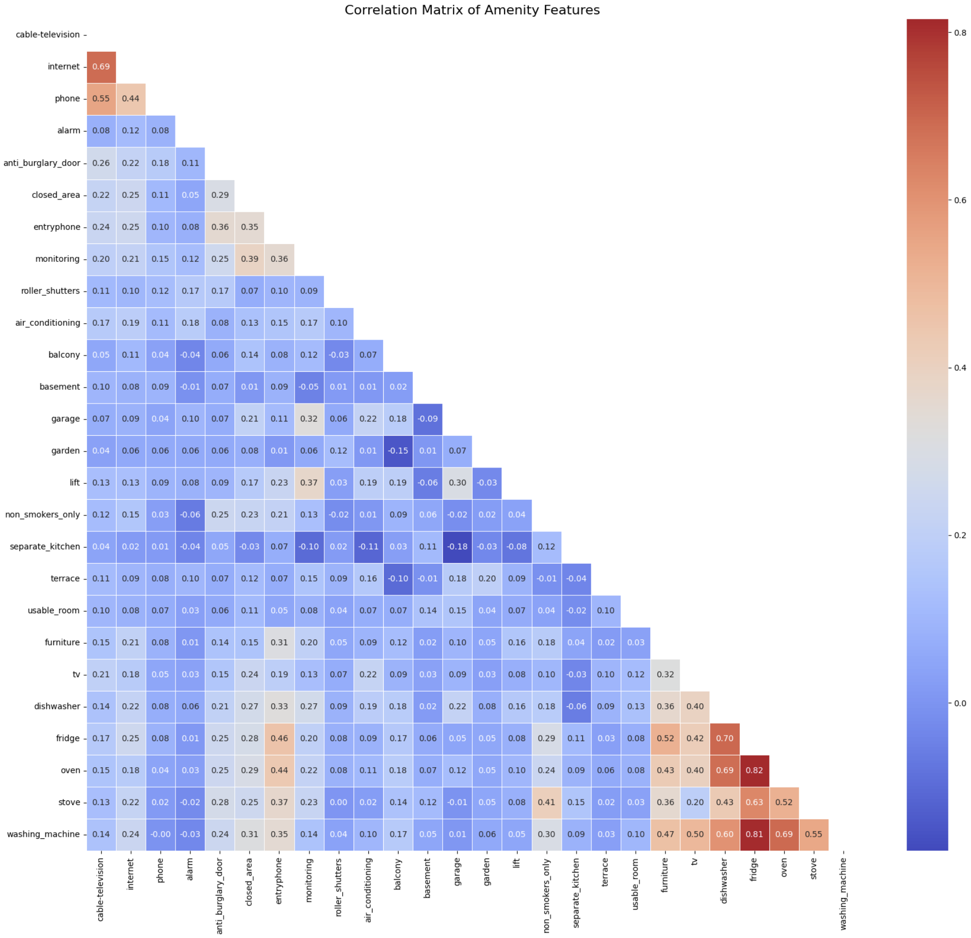

Slide 21
Amenity groupings based on correlation patterns:
kitchen_furniture_amenities : washing_machine, oven, fridge, dishwasher, tv, furniture, stove
security_amenities : anti_burglary_door, closed_area, entryphone, monitoring, non_smokers_only
tech_amenities : cable-television, phone, internet
premium_amenities : garden, terrace, air_conditioning, roller_shutters, alarm
infrastructure_amenities : lift, balcony, garage
interior_amenities : separate_kitchen, usable_room, basement

Slide 22
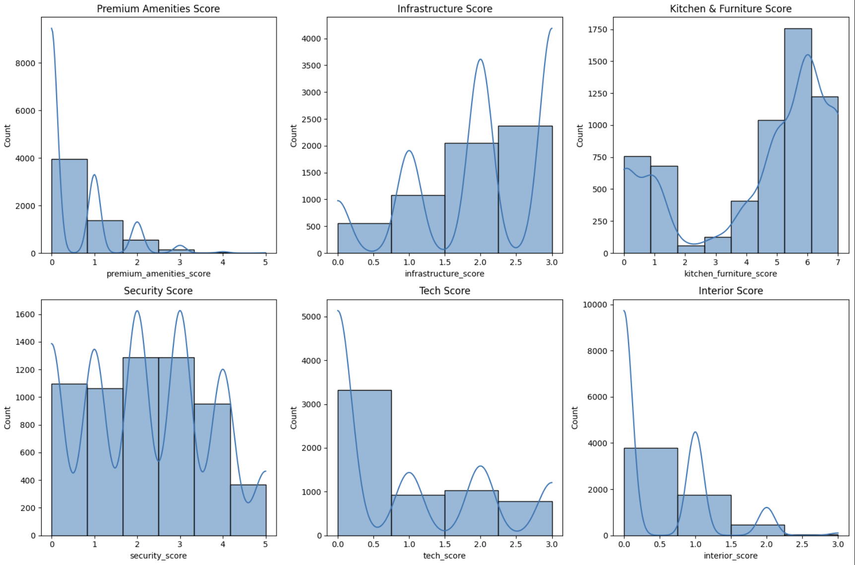

Slide 23
Price outliers
Outlier thresholds (1.5 IQR method):
Lower bound: -846.88
Upper bound: 11388.12
Number of outliers: 595 (9.83% of the data)
Outlier range: 1250.00 to -846.88 and 11388.12 to 57000.00
The data is right-skewed (many more high prices than low prices). The IQR method assumes a symmetric distribution. When applied to skewed data, it can produce impossible thresholds

Slide 24
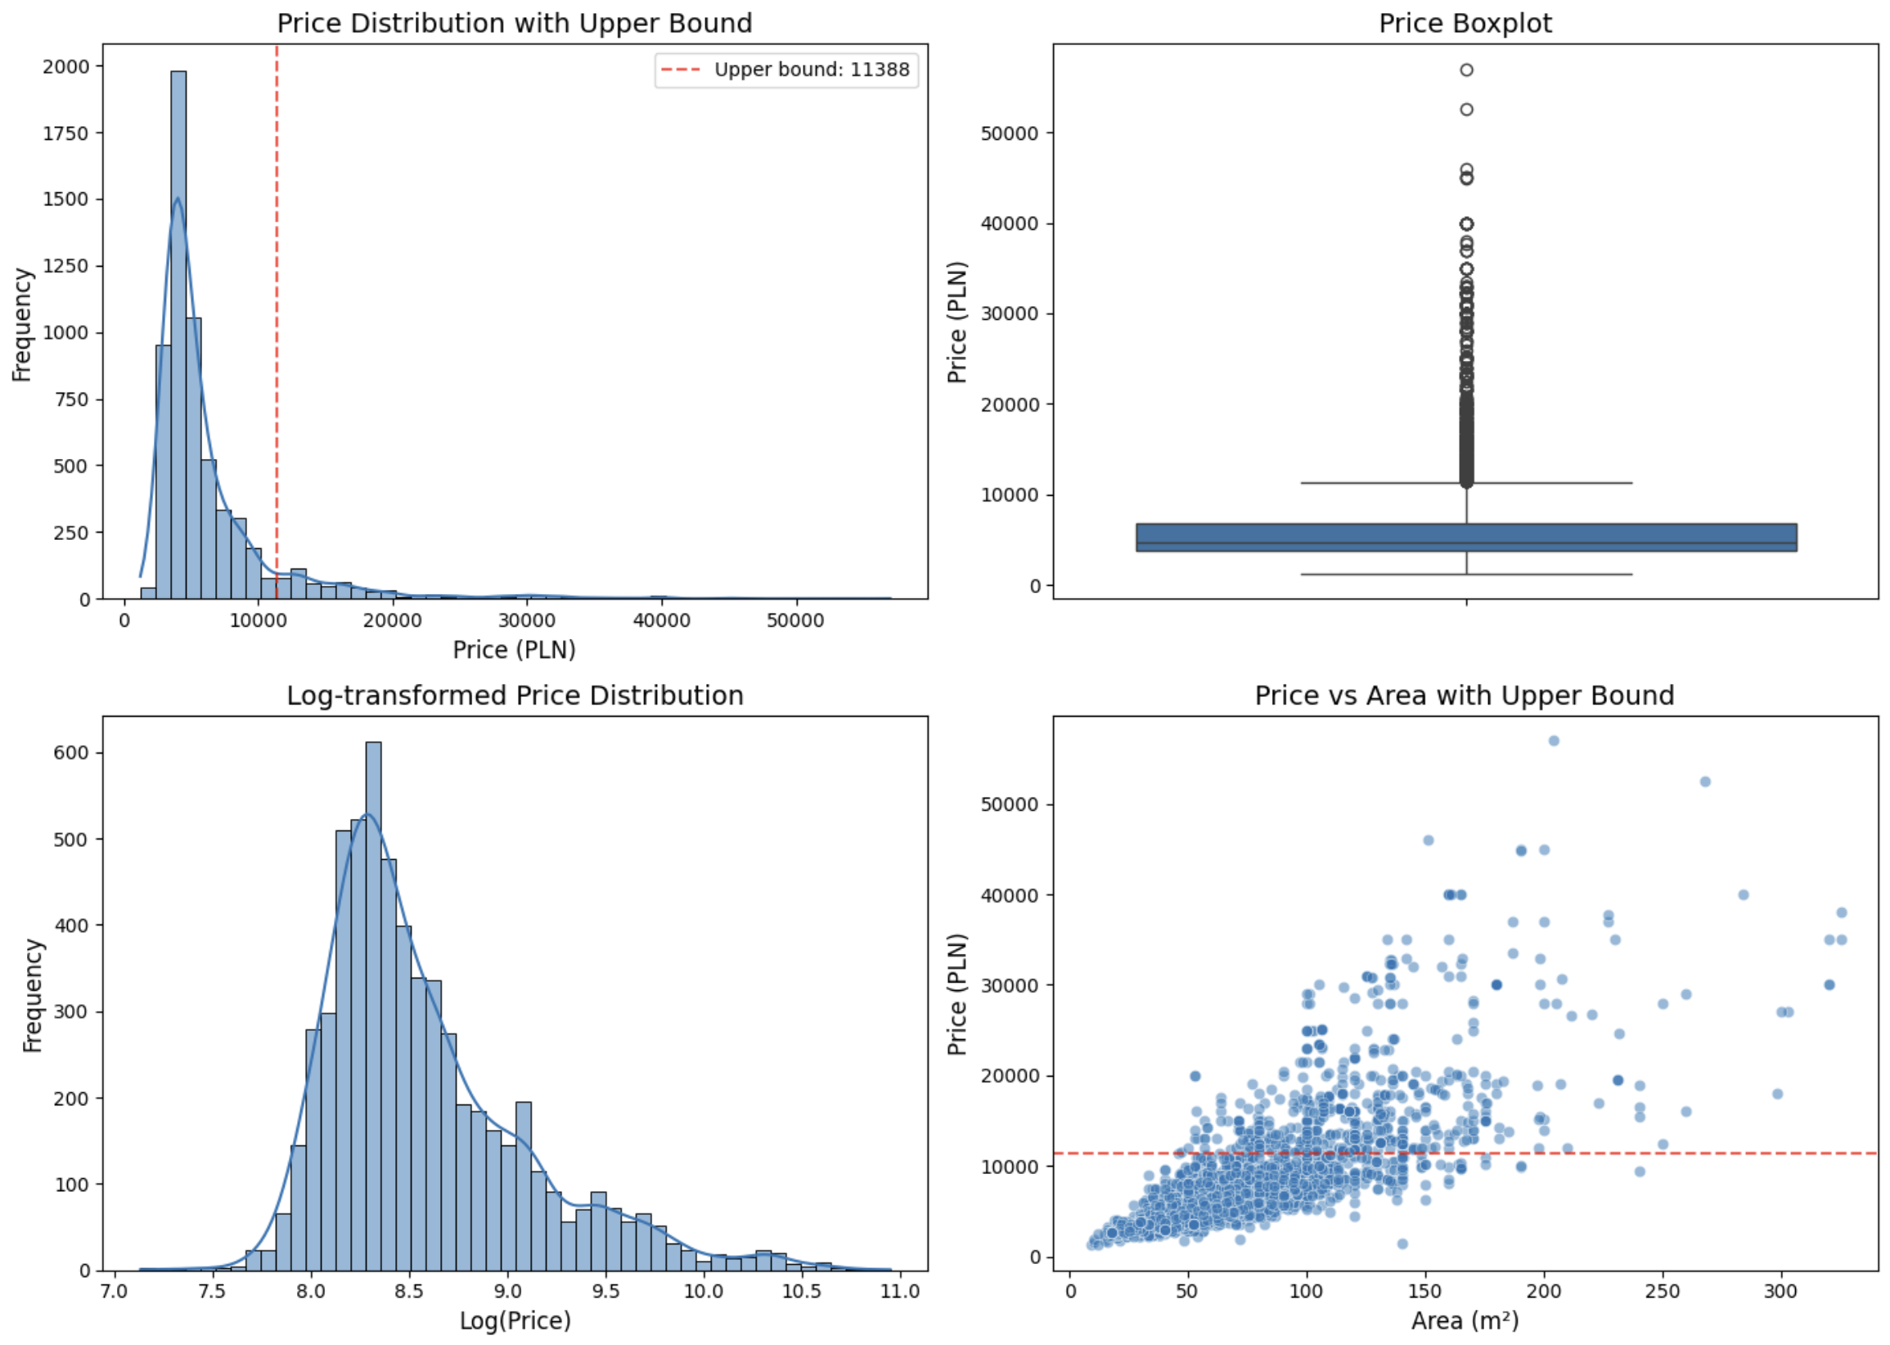
Outliers are not errors. We need: df['log_price'] = np.log(df['total_price’])

Slide 25
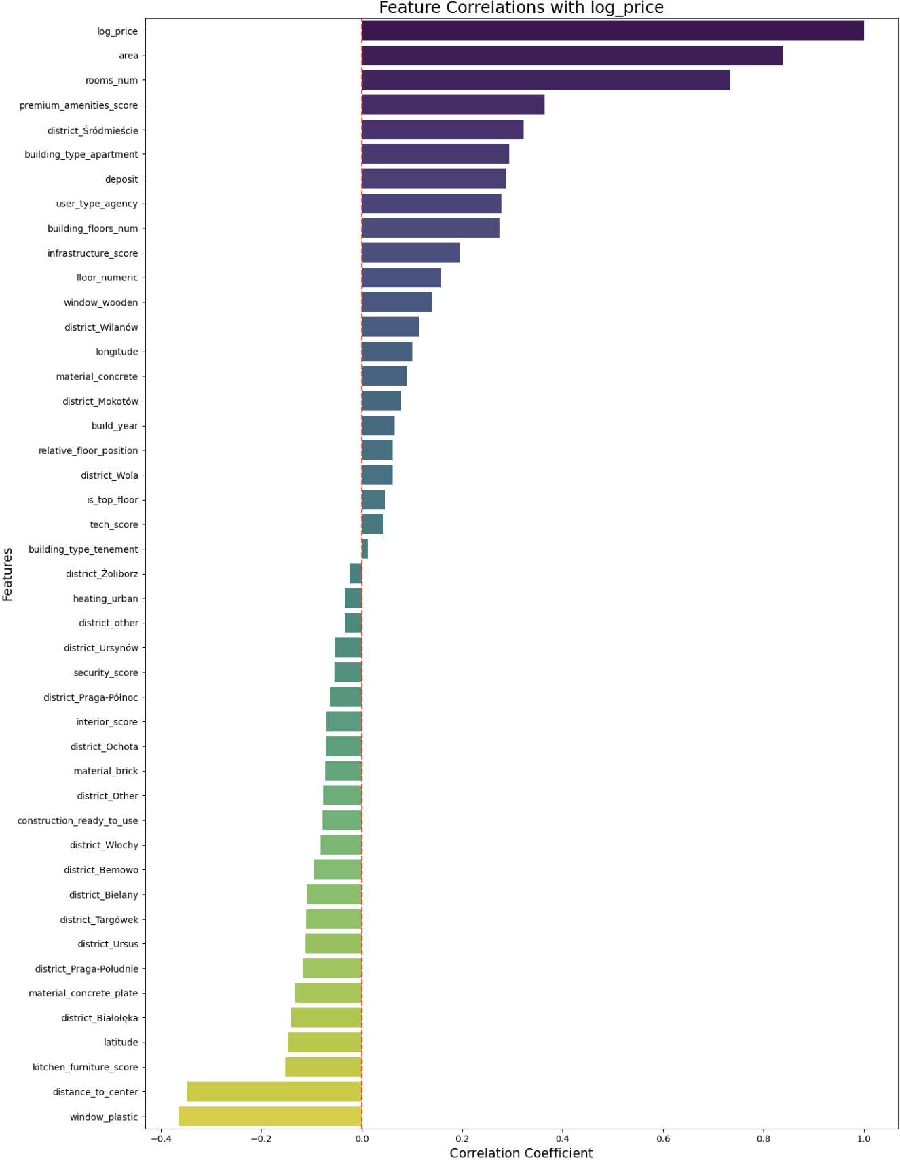

Slide 27
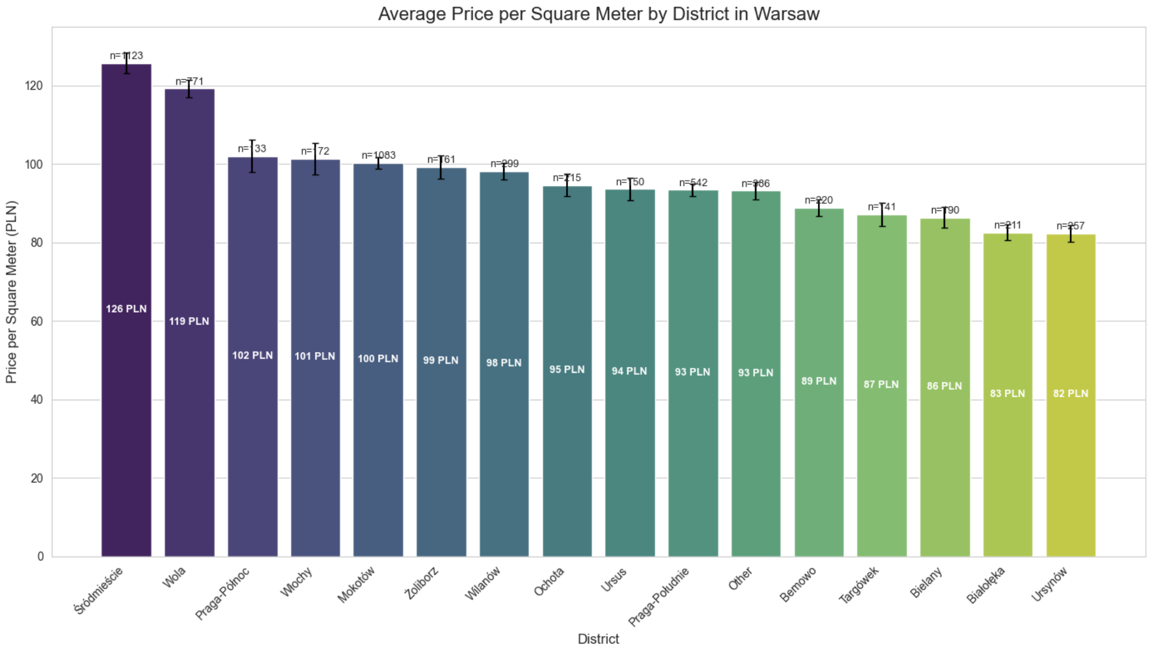

Slide 28
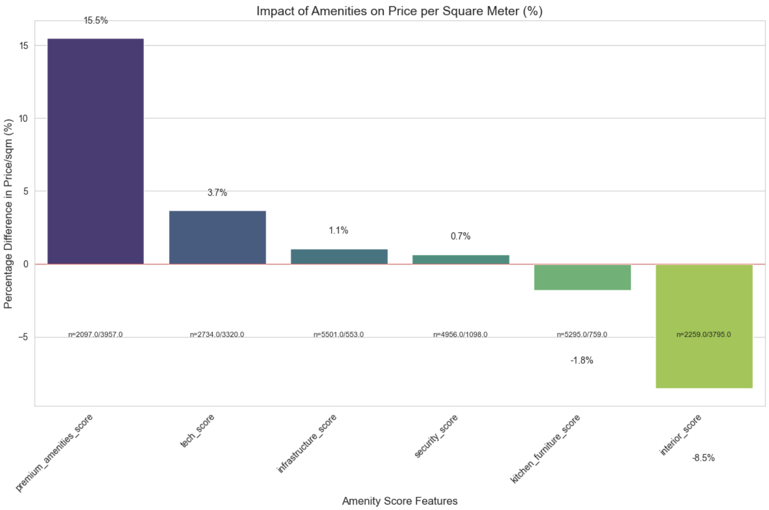

Slide 29
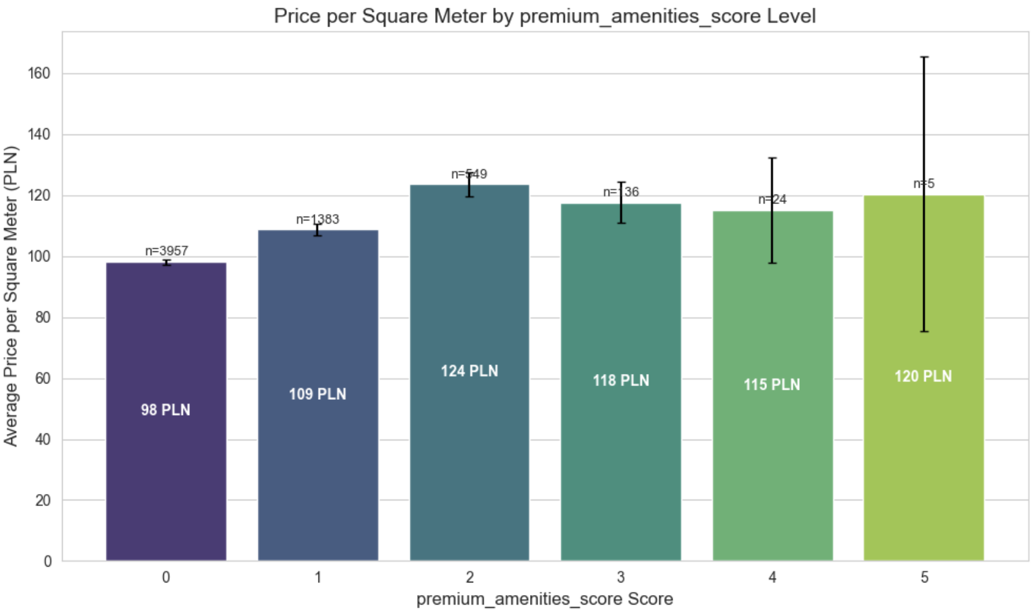

Slide 30
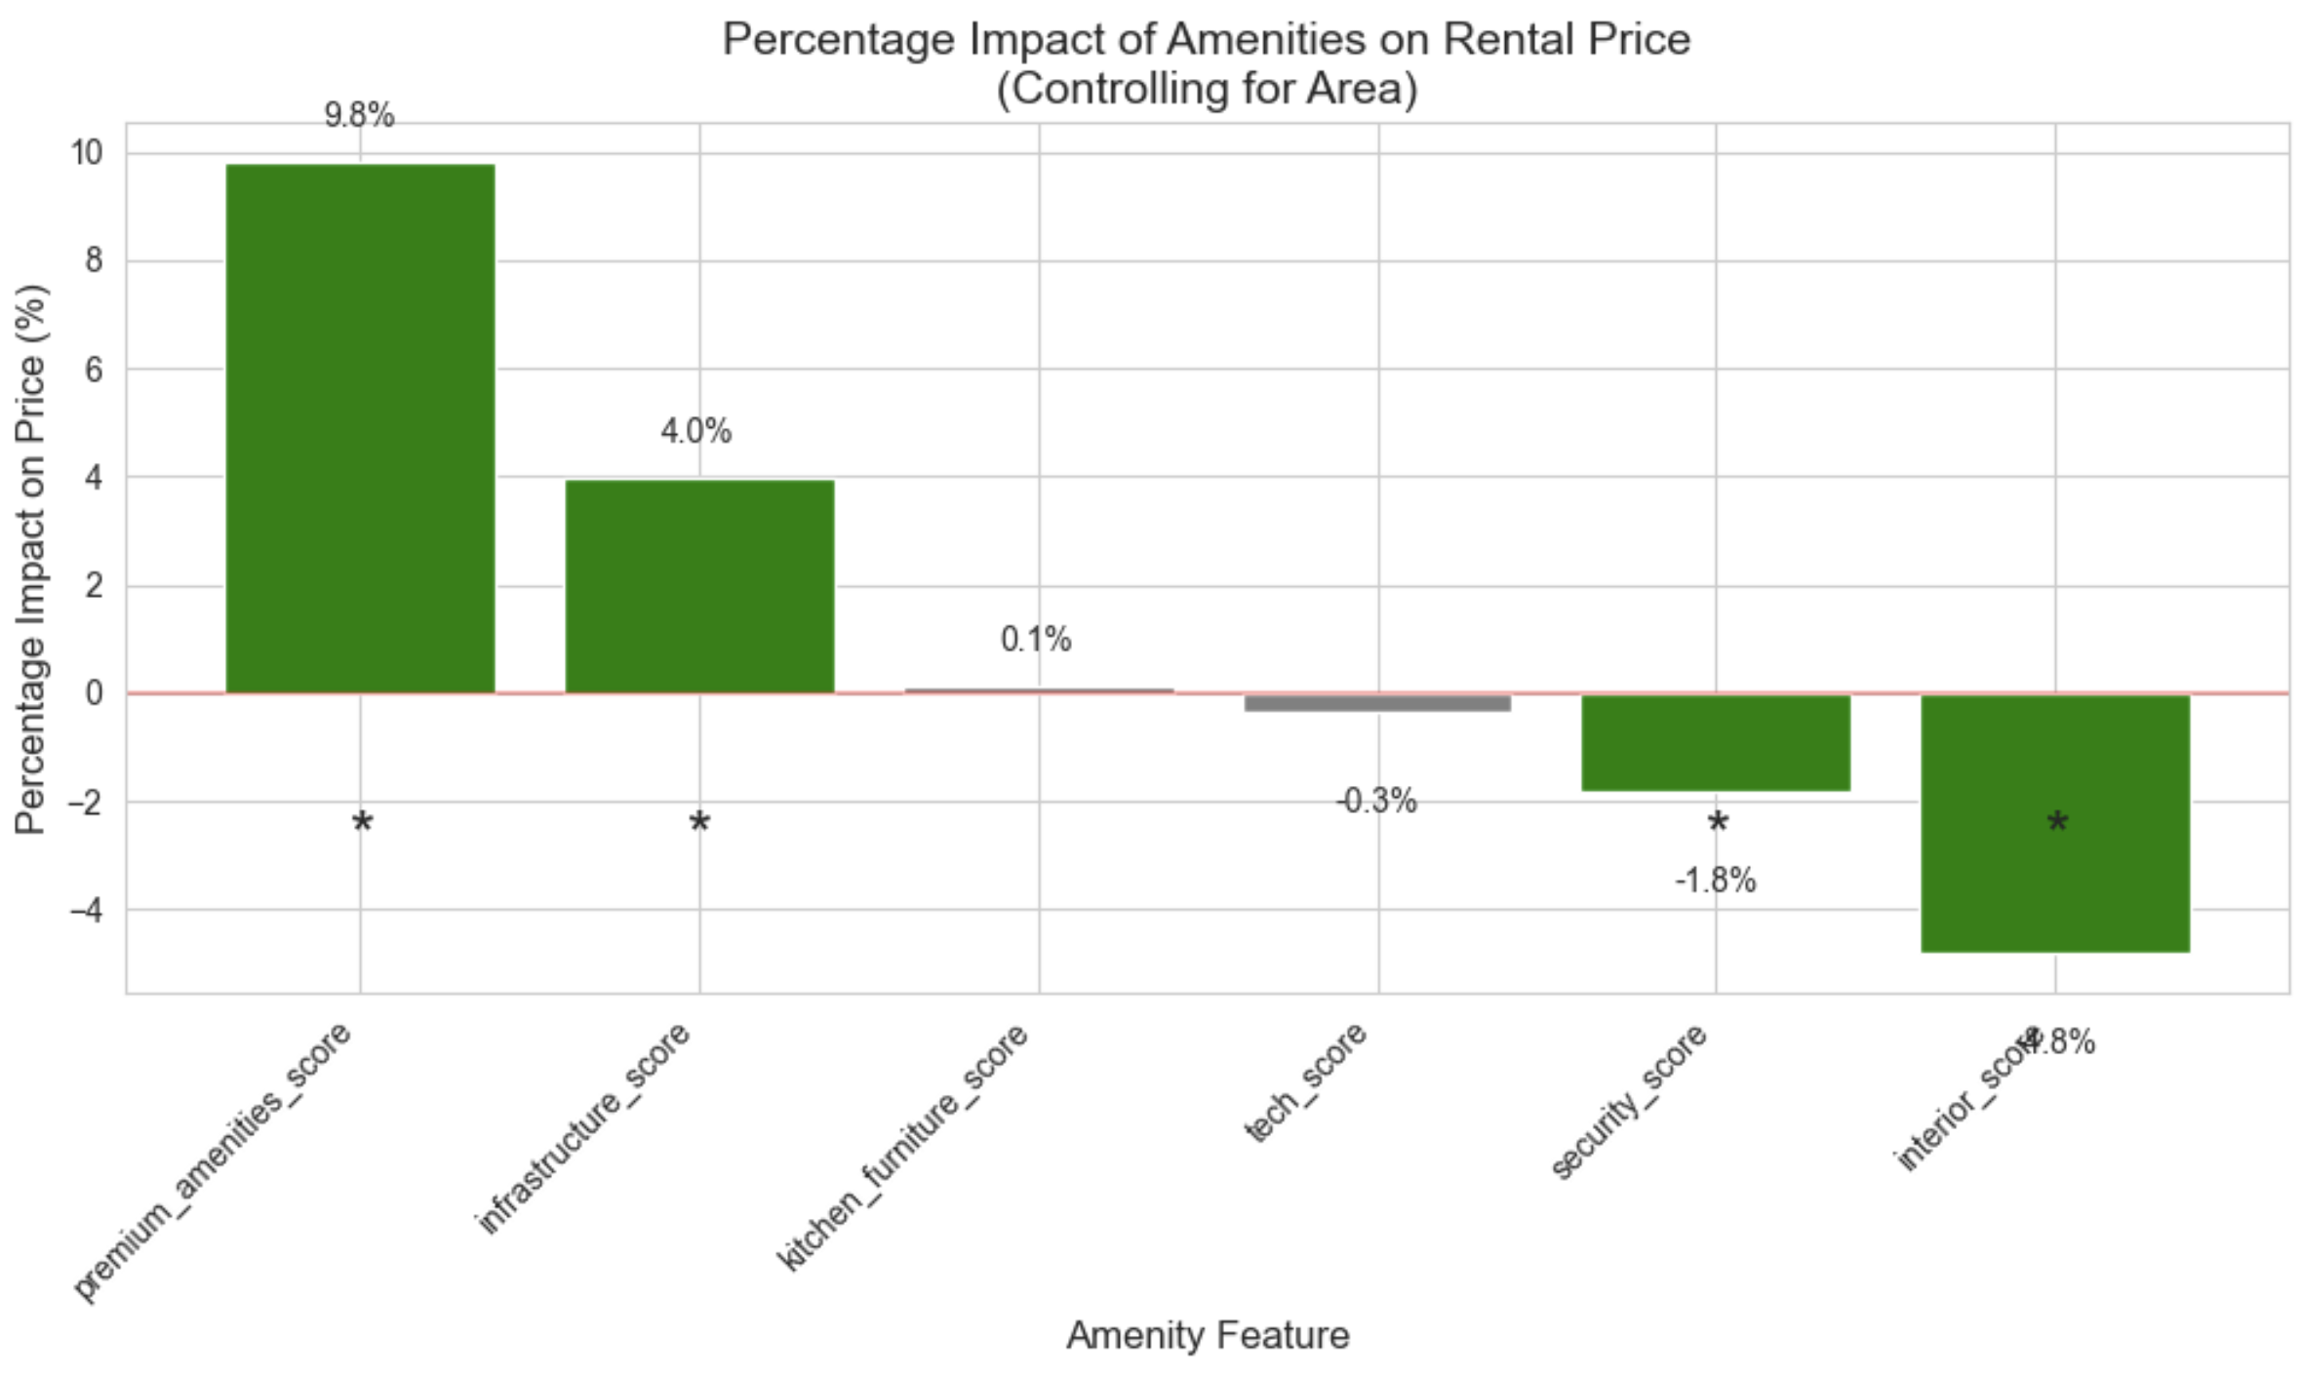

Slide 31
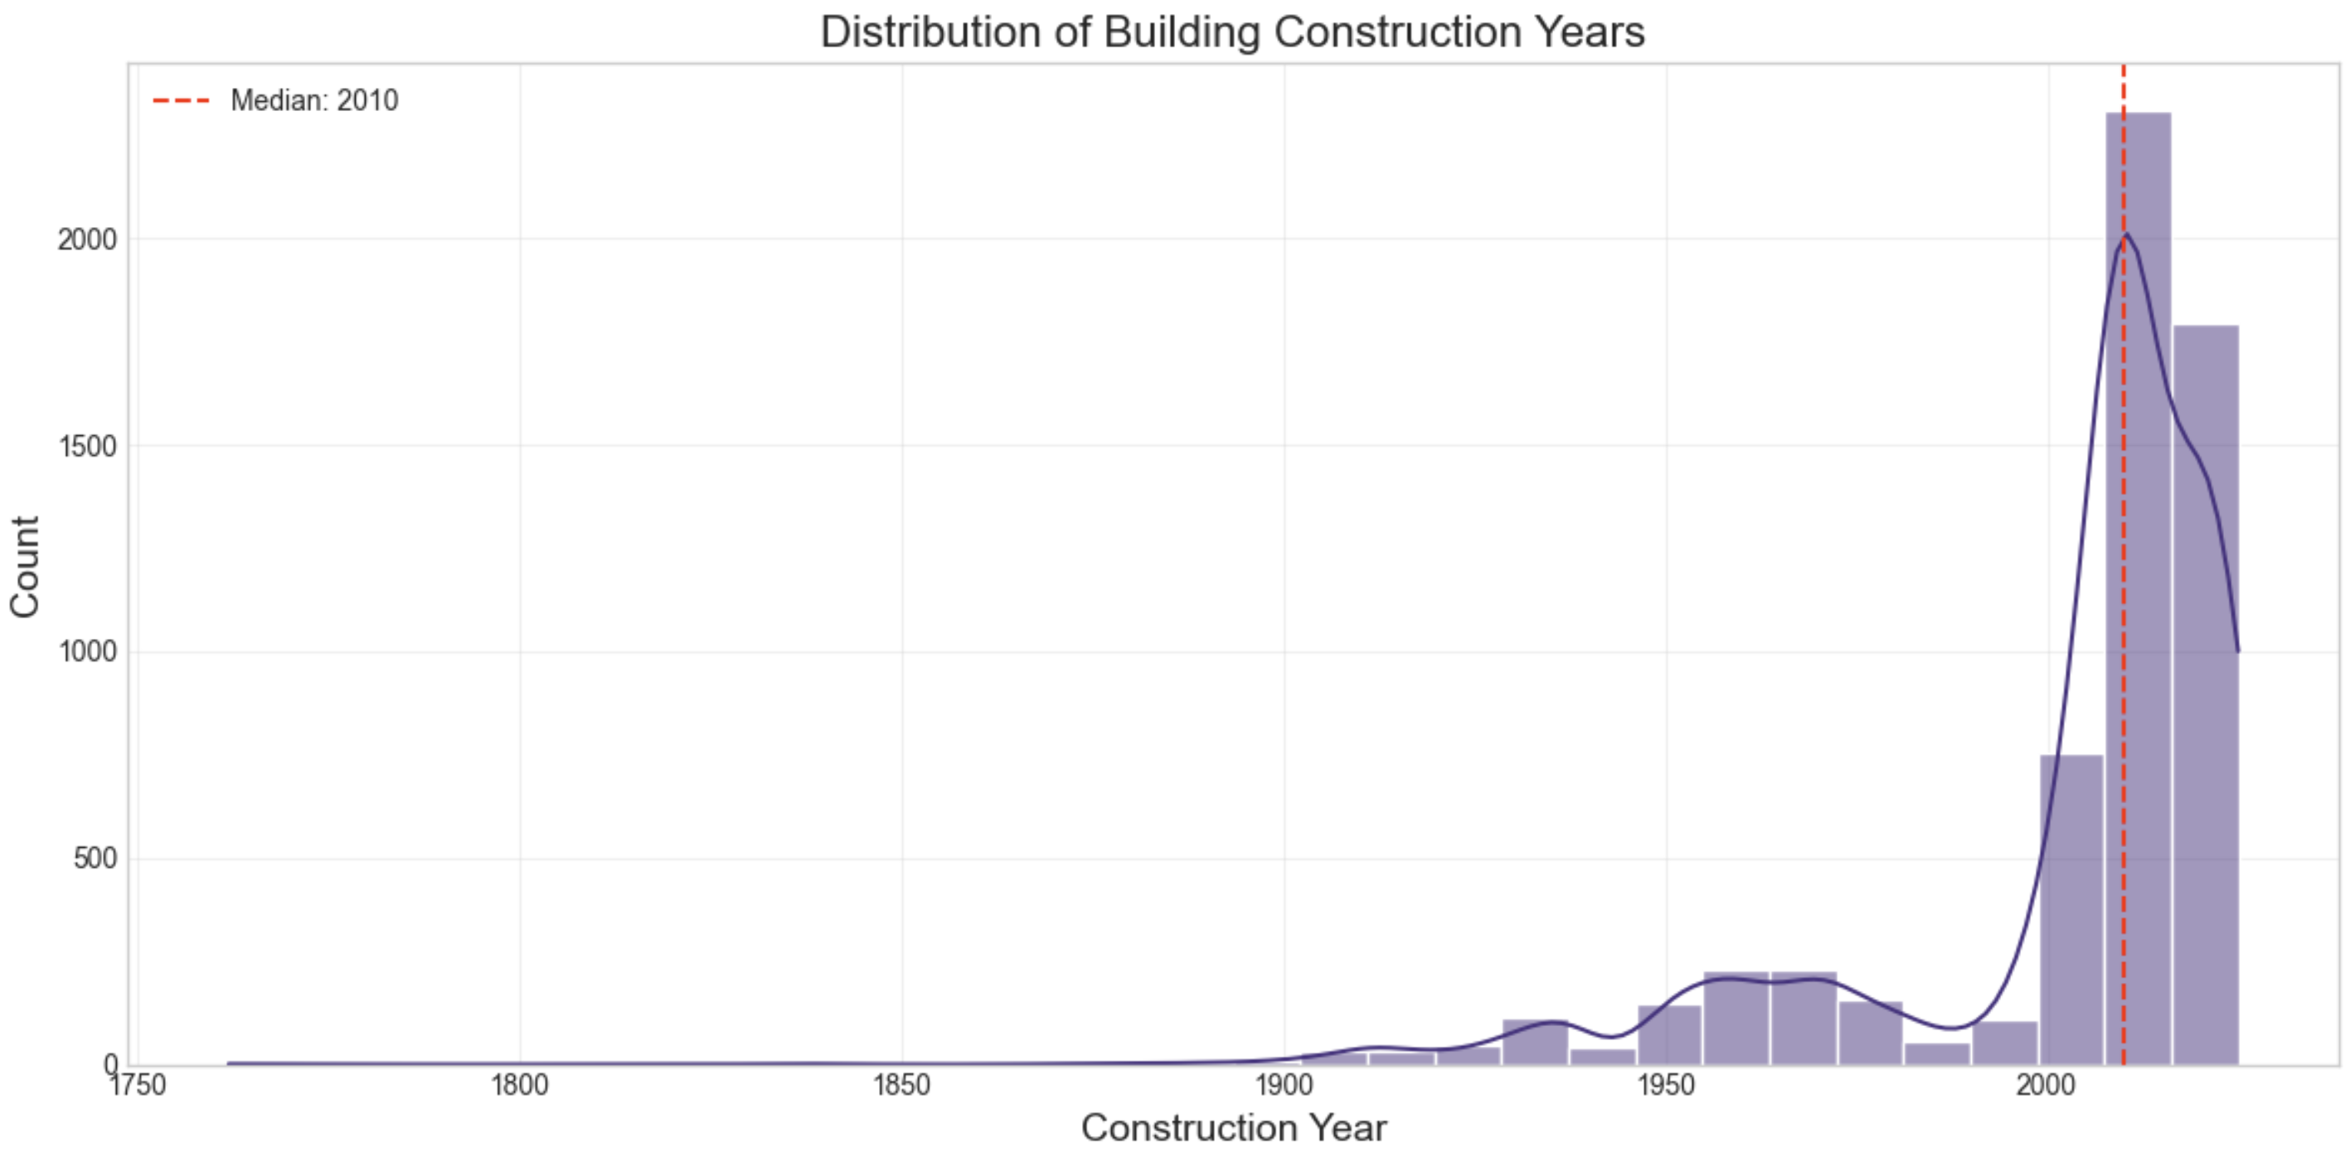

Slide 32
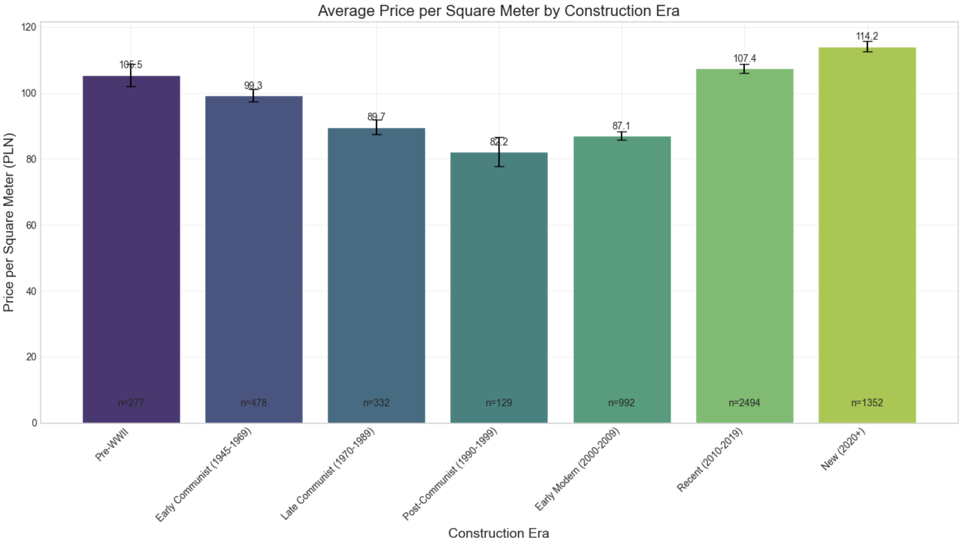

Slide 33
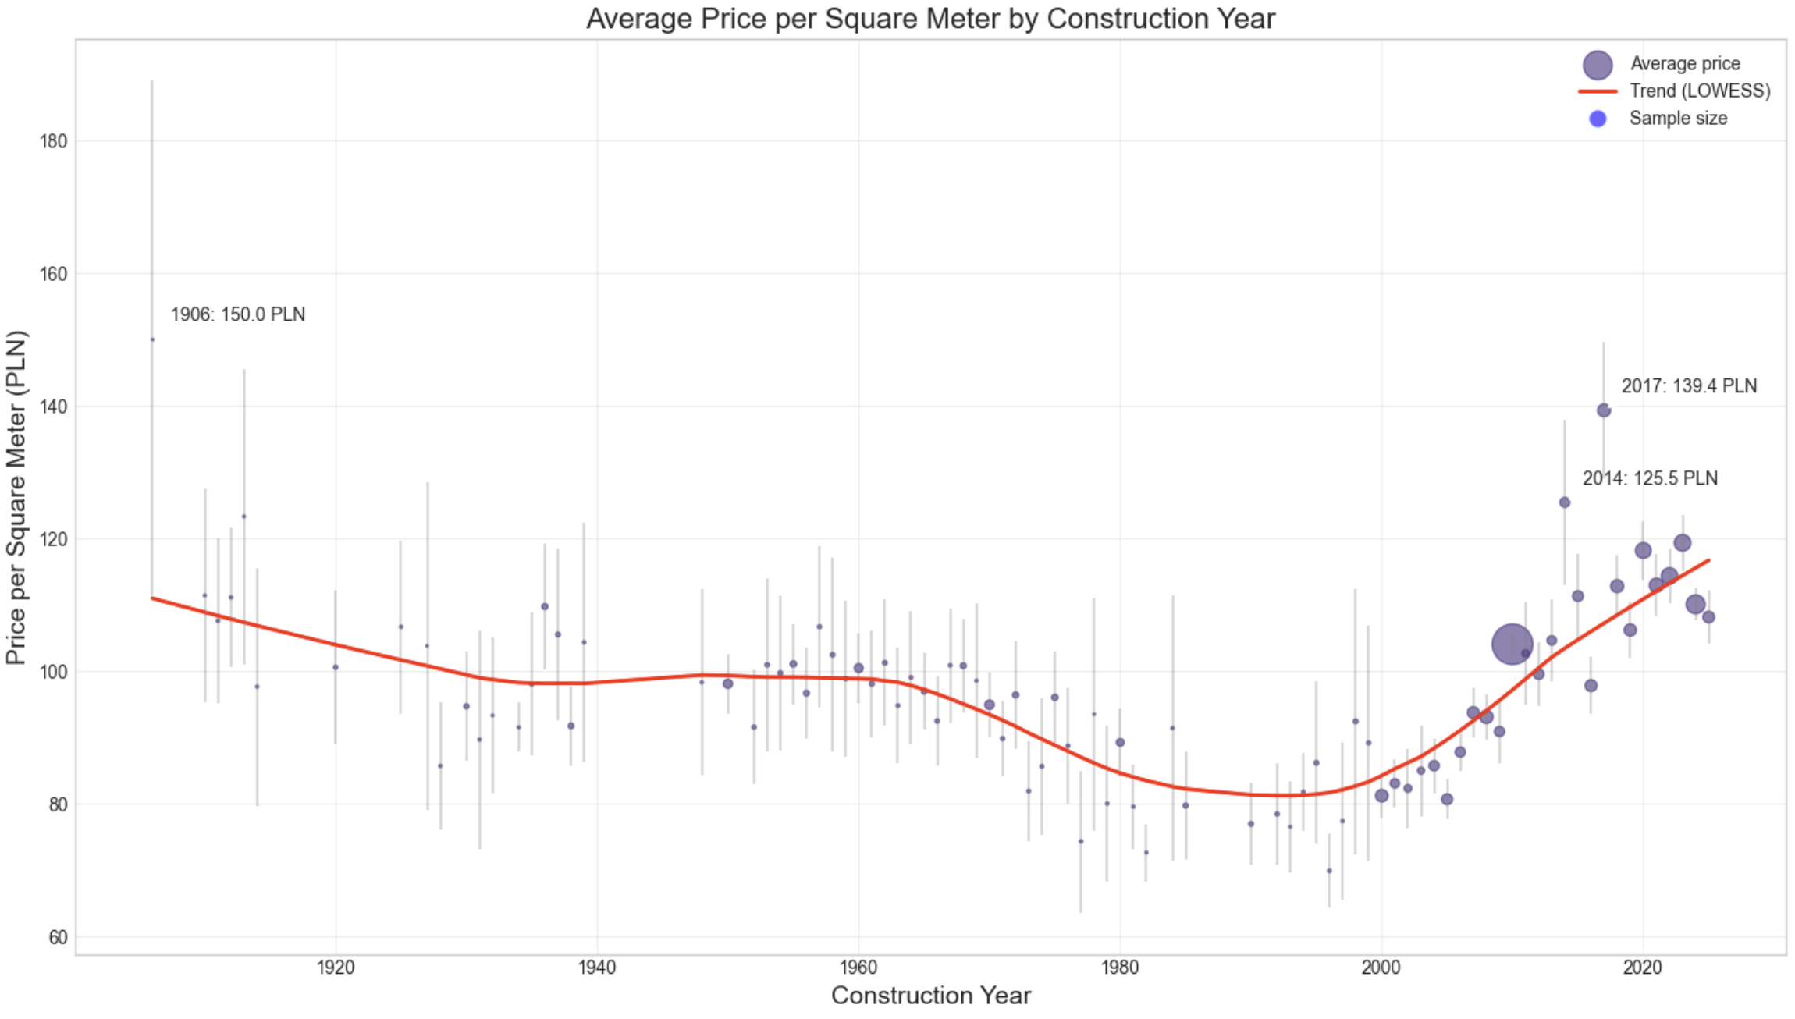

Slide 34
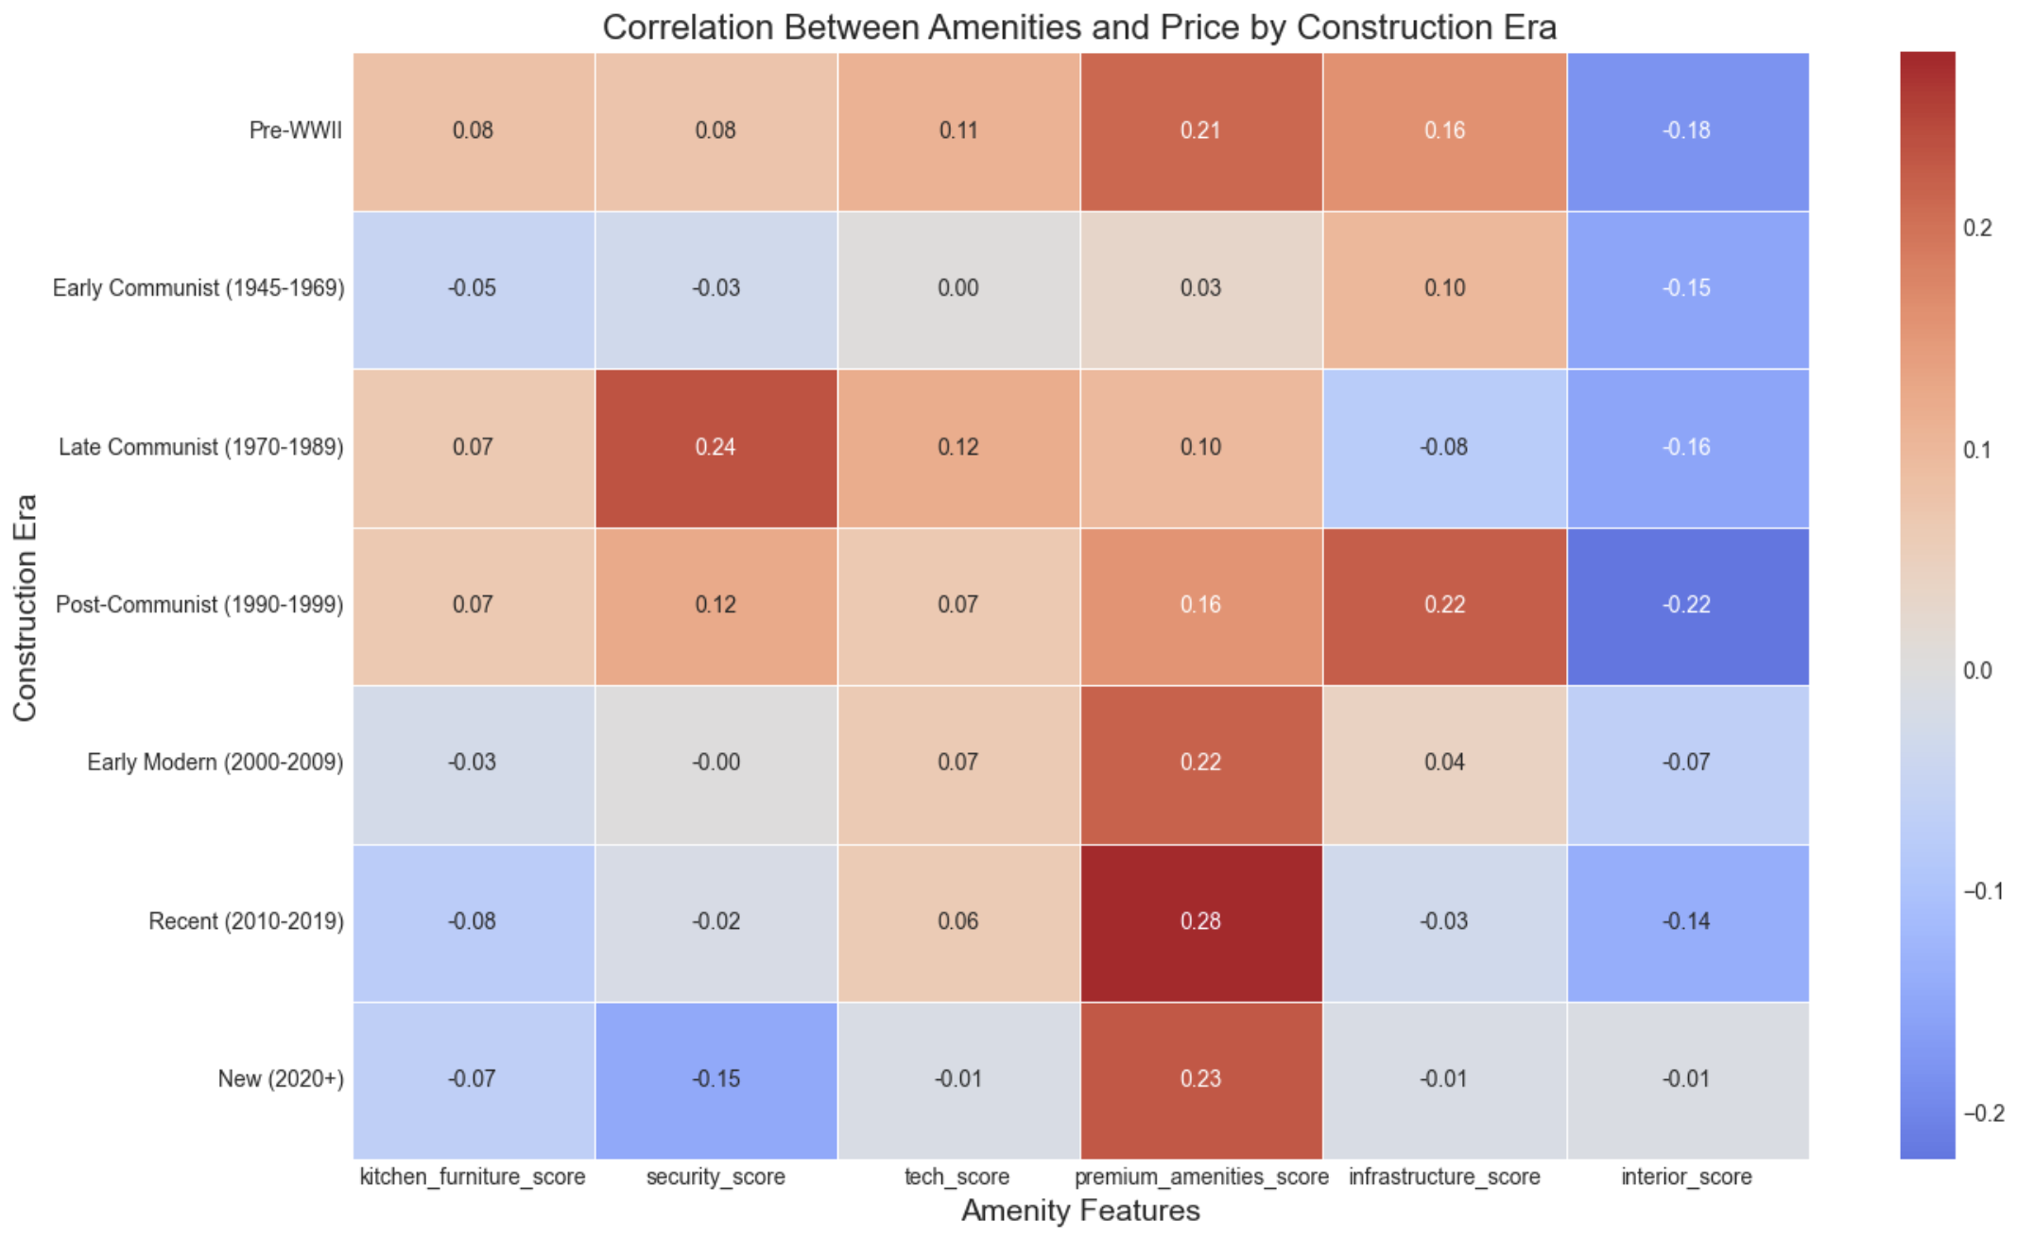

Slide 35
I standardize (z-score normalization) variables: 'area', 'distance_to_center', 'building_floors_num', 'floor_numeric', 'build_year', 'deposit', 'relative_floor_position'
Execution of section 3 and 4: 3-1.py and 3-2.py

Slide 36
5. Modeling & 6. Evaluation
Model Validation Results:
RMSE MAE R² MAPE (%)
RandomForest 0.159973 0.110268 0.911811 11.191945
GradientBoosting 0.166026 0.119144 0.905011 11.979981
Ridge Regression 0.213093 0.152403 0.843521 15.613161
Linear Regression 0.213121 0.152426 0.843480 15.616803
ElasticNet 0.219517 0.156787 0.833944 15.962804
Lasso Regression 0.225595 0.161125 0.824622 16.369156
Best model: RandomForest

Slide 37
Best model performance on test set:
RMSE: 0.1526
MAE: 0.1055
R²: 0.9121
MAPE (%): 10.6088
feature | importance
area | 0.748365
distance_to_center | 0.077998
building_floors_num | 0.035192
build_year | 0.033789
rooms_num | 0.018465
premium_amenities_score | 0.008912
relative_floor_position | 0.008154
floor_numeric | 0.007240
kitchen_furniture_score | 0.006610
infrastructure_score | 0.006602

Slide 38
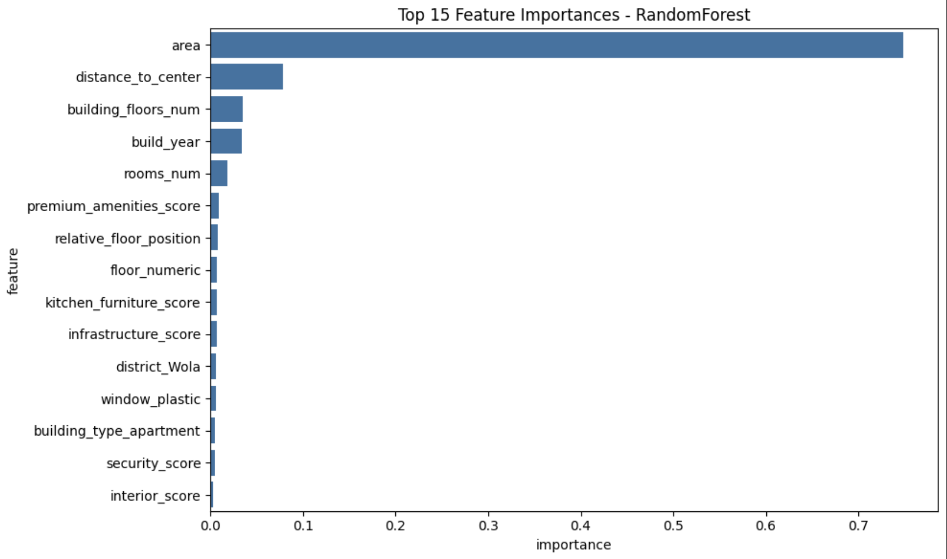

Slide 39
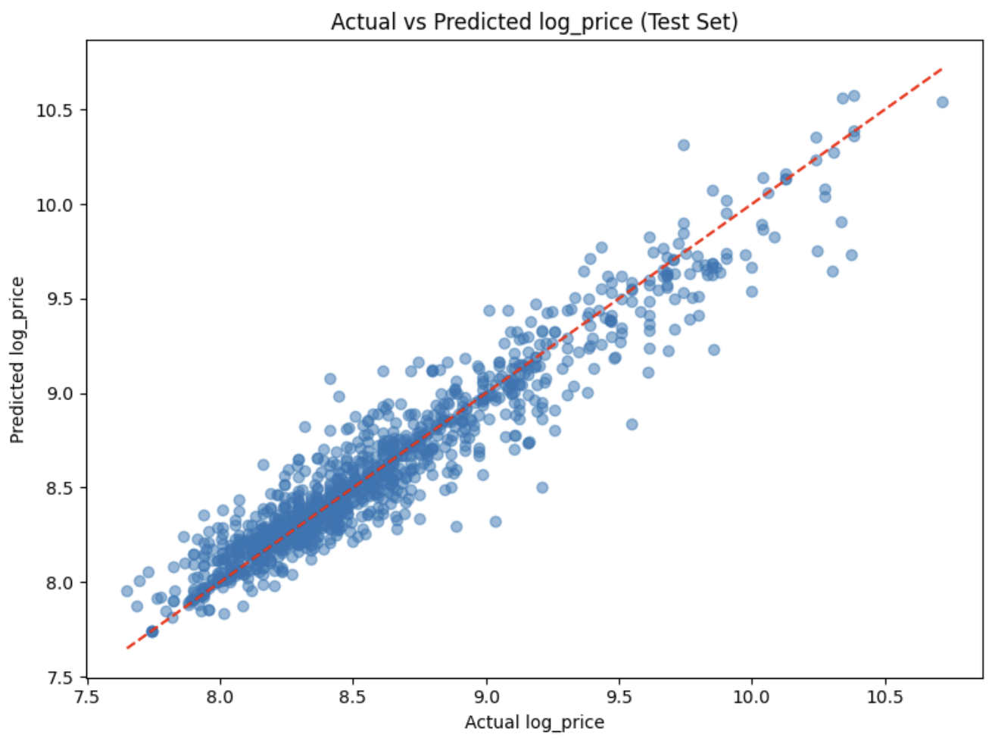

Slide 40
Feature engineering:
Valuable features: area_per_room, area_distance_interaction, high_premium_district, building_age, top_floor_distance
Validation set performance:
RMSE: 0.1589
R²: 0.9130
MAPE: 11.18%
Performing hyperparameter tuning...
Best parameters: {'max_depth': 20, 'min_samples_leaf': 1, 'min_samples_split': 2, 'n_estimators': 200}
Tuned model validation performance:
RMSE: 0.1584
R²: 0.9135
MAPE: 11.13%
Final model performance on test set:
RMSE: 0.1539
R²: 0.9106
MAPE: 10.88%

Slide 41
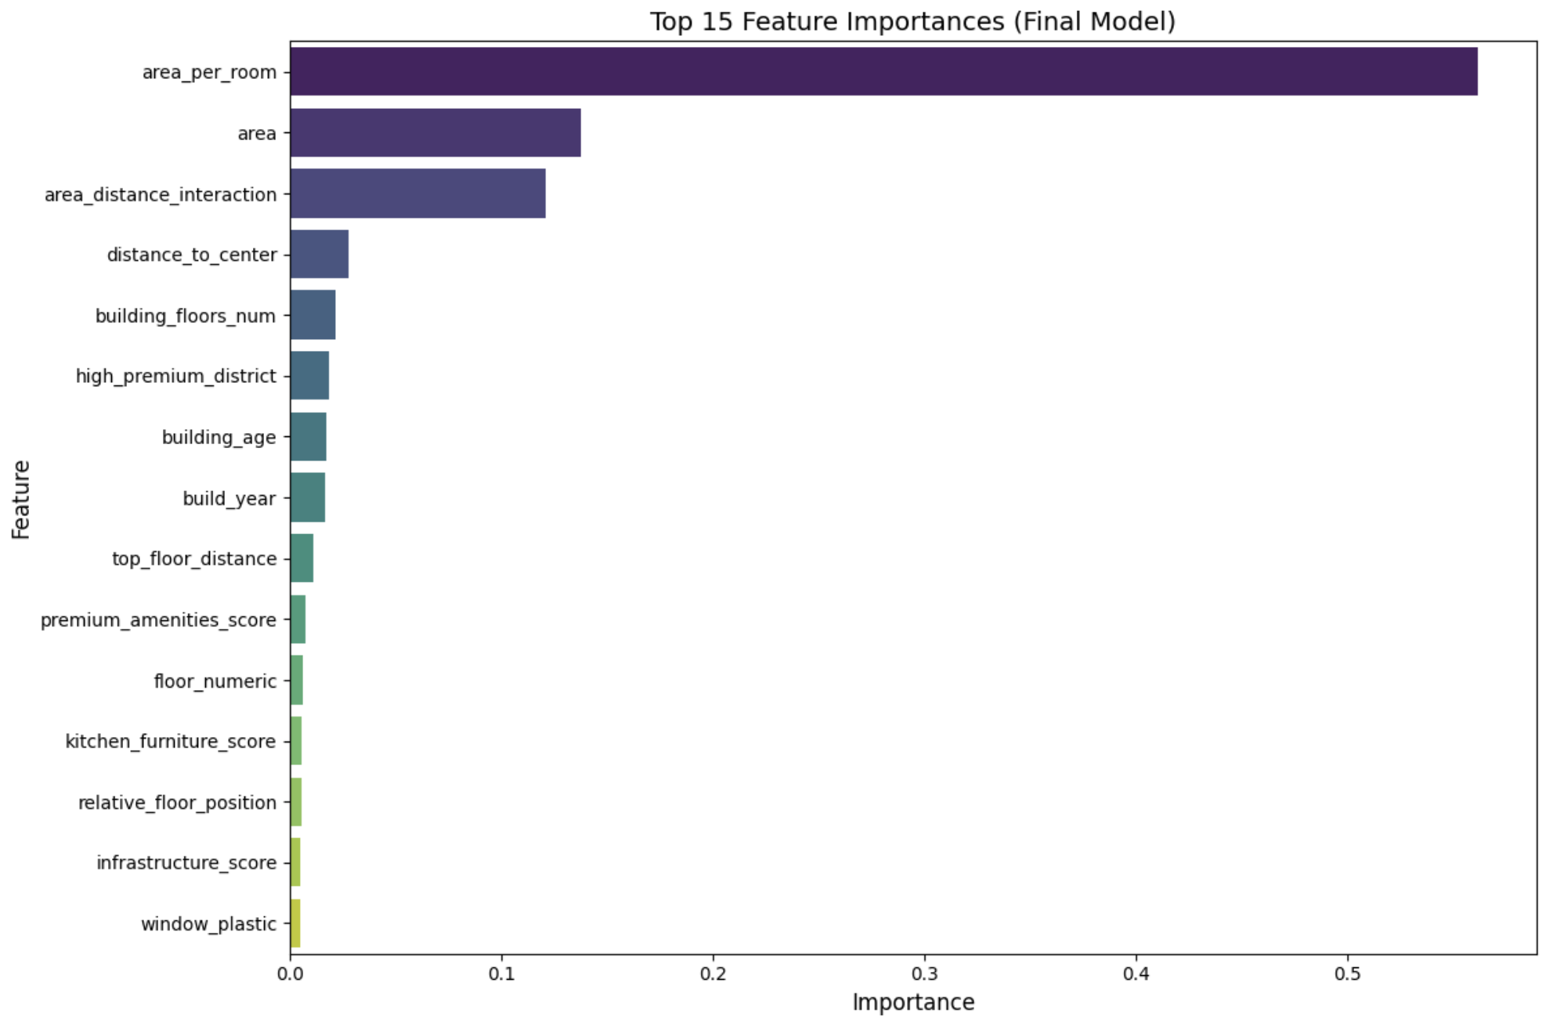

Slide 42
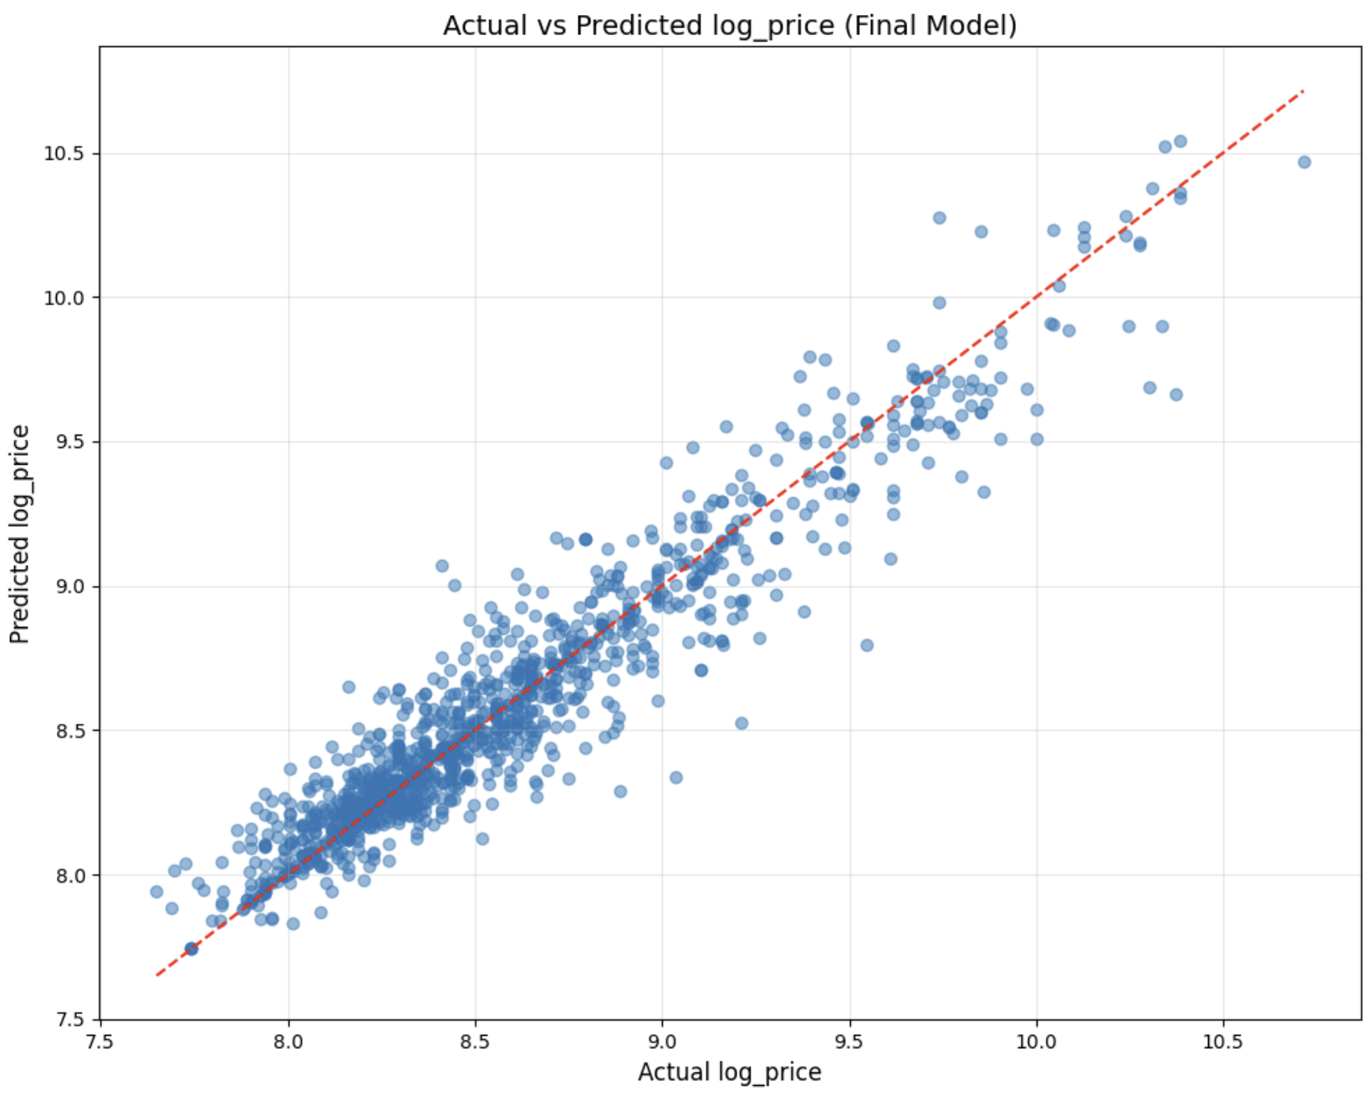

Slide 43
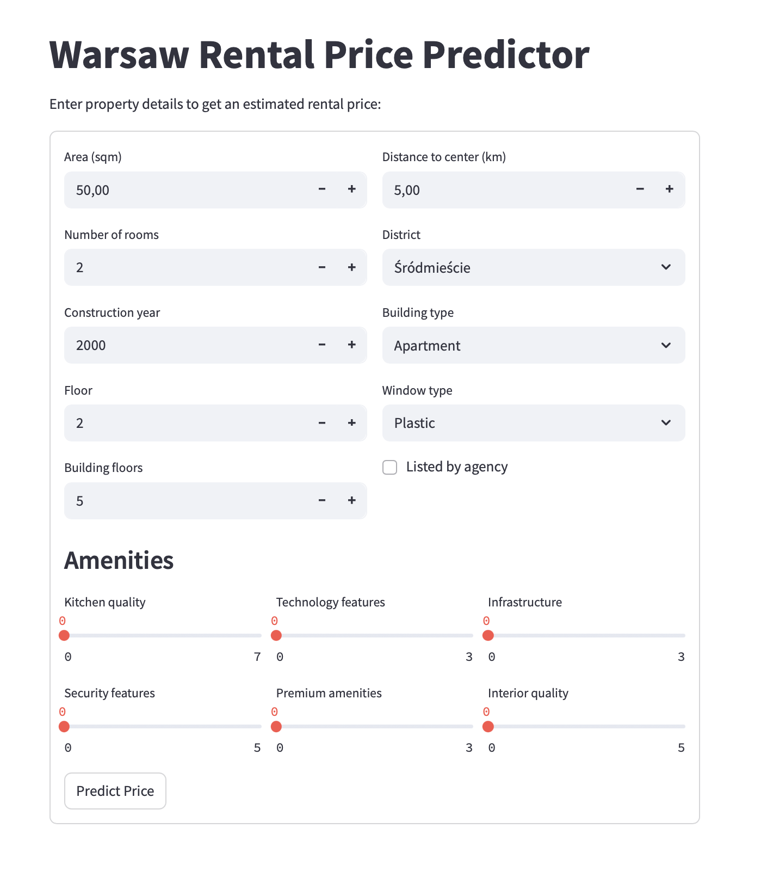
7. Deployment & Communication

